Slide 1
Case Presentation
Patient Name : X
Age : 33
Husband age : 35
History : primary infertility
married life 3 Yrs
Menstrual history : regular menstrual cycles
3/30 days, normal flow
spasmodic dysmenorrhoea
pain starts on day 1 of cycle, lasts for 2 days not associated with vomitings or giddiness

Slide 2
Case Presentation
Past medical history:
Not a known hypertensive, diabetic, hypothyroid, asthmatic
Past surgical history:
Nil significant
Family history:
Nil significant
Past infertility record:
Tried a few cycles of CC 100mg – unmonitored cycles

Slide 3
Case Presentation
Husband history:
No significant medical problems
Not a smoker/alcoholic
No coital problems
Coital frequency: 2-3/week
On examination:
general examination is normal
height - 160 cm
weight - 62 kgs
BMI - 24.2

Slide 4
Case Presentation
P/A – soft, no mass palpable
P/S – cervix is healthy, no discharge
P/V – uterus is retroverted, restricted mobility, no fornicial masses, no tenderness
Breasts – normal, no galactorrhoea

Slide 5
Case Presentation
Investigations
CBP - normal
S.TSH - 1.3 miu/ml
S.PRL - 7.6 ng/ml
GTT - 98/195/135 mg/dl
HBA1c - 6.0%
Viral markers - Negative
Any other routine investigations you would like to advice

Slide 6
Case Presentation
Ultrasound Report
Uterus - retroverted, normal sized
Endometrium - 4 mm
Right ovary - AFC is 8
Left ovary - AFC is 5
evidence of a large cyst with internal echoes and ground glass appearance measuring 4cm

Slide 7
Case Presentation

Slide 8
Case Presentation
Any other investigations you would like to advice

Slide 9
Case Presentation
CA 125 - 60.4 U/ml
FSH - 7.94 mIu/ml
LH - 5.48 mIu/ml
AMH - 4.7 ng/ml
Husband semen analysis -
volume - 1.4ml
pH - alkaline
Total count - 100M/ml
Motility - 53 - 30 - 17
Morphology - normal 10%

Slide 10
Case Presentation
How do we proceed with this case??

Slide 11
Role of MRI in the diagnosis of endometriosis
At present, there is insufficient evidence to indicate that magnetic resonance imaging (MRI) is a useful test to diagnose or exclude endometriosis compared to laparoscopy.
MRI reserved for equivocal ultrasound results in cases of rectovaginal or bladder endometriosis.

Slide 12
Treatment modalities you would like to offer

Slide 13
Role of laparoscopy in the primary management of endometriosis

Slide 14
Case Presentation
The patient underwent operative hyterolaparoscopy
Uterus – normal
Right adnexa – tube normal, tuboovarian relation normal, chromotubation -- positive
Right Ovary -- surface endometriosis fulgurated
Left adnexa – tube densely adherent to ovarian fossa, adhesiolysis done, patency established
Left ovary – large endometrioma adherent to the uterus, endometrioma excised
Uterosacrals - endometriosis fulgurated
POD – POD completely obliterated with dense adhessions

Slide 16
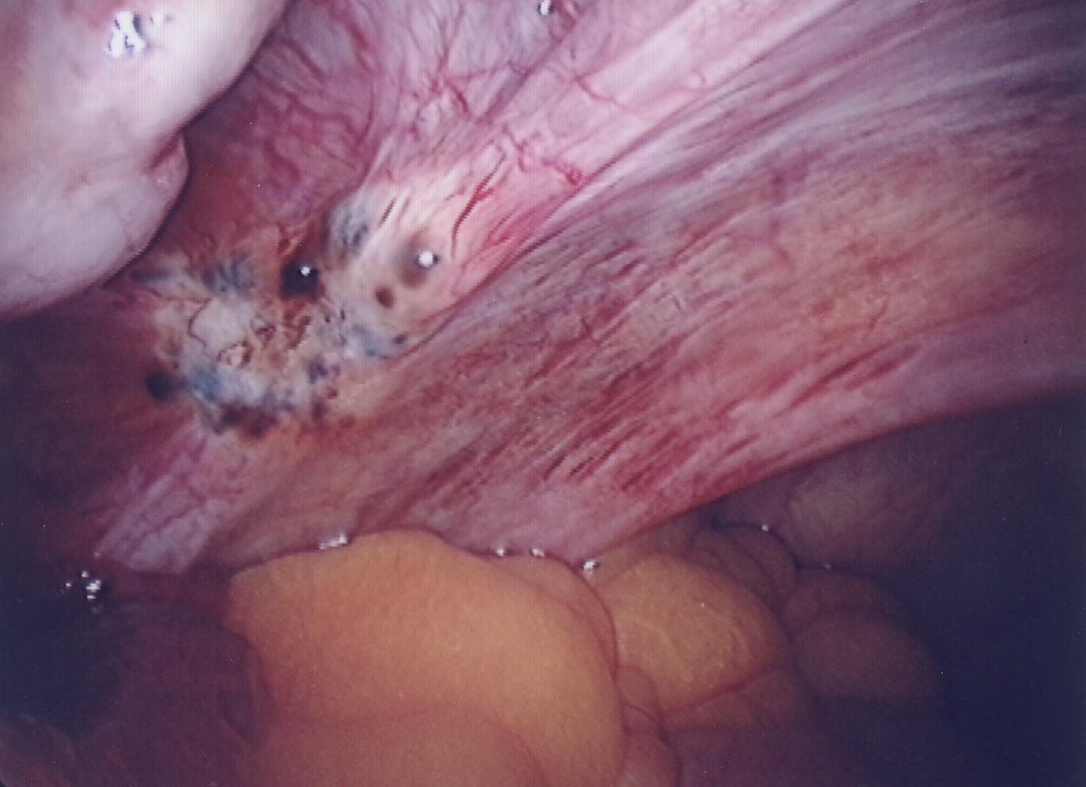

Slide 17
Biologic Mechanisms That Might Link Endometriosis and Infertility
Distorted pelvic anatomy
Altered peritoneal function
Altered hormonal & cell-mediated function
Endocrine and ovulatory abnormalities
Impaired implantation
Oocyte and embryo quality
Abnormal uterotubal transport

Slide 18
When To Do Laparoscopy?
Younger women (?<37 years of age)
Short duration of infertility (<4 years)
Normal male factor
Normal or treatable uterus
Normal ovulation, or
Easily treatable ovulation disorder
Limited prior treatment
Appropriate candidate for laparoscopy
“Treatable” disease reasonably suspected (NNT)
OR= 1.66 (1)
No contraindications to laparoscopy
Patient accepts 9-15 months attempting before IVF

Slide 19
Endometriomectomy: Surgical Principles
Recommendations:
In infertile women with ovarian endometrioma undergoing surgery, clinicians should perform excision of the endometrioma capsule, instead of drainage and electrocoagulation of the endometrioma wall, to increase spontaneous pregnancy rates (Hart et al., 2008).
The GDG recommends that clinicians counsel women with
endometrioma regarding the risks of reduced ovarian function after surgery and the possible loss of the ovary. The decision to proceed with surgery should be considered carefully if the woman has had previous ovarian surgery.

Slide 20
Role of hormone therapy
Recommendation:
In infertile women with endometriosis, clinicians should not prescribe hormonal treatment for suppression of ovarian function to improve fertility (Hughes, et al., 2007)

Slide 21
Role of hormone therapy
Recommendations:
In infertile women with endometriosis, the GDG recommends clinicians not to prescribe adjunctive hormonal treatment before surgery to improve spontaneous pregnancy rates, as suitable evidence is lacking.
In infertile women with endometriosis, clinicians should not prescribe adjunctive hormonal treatment after surgery to improve spontaneous pregnancy rates (Furness, et al., 2004).

Slide 22
How to proceed next with the case ???

Slide 23
How to proceed next with the case ???
Patient underwent
3 cycles of COH + FI + IUI

Slide 24
Recommendations for treatment following laparoscopy in patients with endometriosis
In infertile women with AFS/ASRM stage I/II endometriosis, clinicians may perform intrauterine insemination with controlled ovarian stimulation, instead of expectant management, as it increases live birth rates (Tummon, et al., 1997).
In infertile women with AFS/ASRM stage I/II endometriosis, clinicians may perform intrauterine insemination with controlled ovarian stimulation, instead of intrauterine insemination alone, as it increases pregnancy rates (Nulsen, et al., 1993).

Slide 25
Recommendations for treatment following laparoscopy in patients with endometriosis
In infertile women with AFS/ASRM stage I/II endometriosis, clinicians may consider performing intrauterine insemination with controlled ovarian stimulation within 6 months after surgical treatment, since pregnancy rates are similar to those achieved in unexplained infertility (Werbrouck, et al., 2006).
The GDG recommends the use of assisted reproductive technologies for infertility associated with endometriosis, especially if tubal function is compromised or if there is male factor infertility, and/or other treatments have failed.

Slide 26
What to do next ???

Slide 27
Now the patient age is 35
AMH is repeated – 0.90ng/ml

Slide 28
ART in endometriosis

Slide 29
Does Surgery prior to IVF improve IVF Success ???

Slide 30
THANK YOU

